Slide 1
Component Life cycle & Change Detection

Slide 2
Change Detection
One view is associated with one component in Angular
A view holds a reference to the associated component class instance in the component property.
All operations like property checks and DOM updates are performed on views.
angular is a tree of views, while a component can be described as a higher level concept of a view.

Slide 3
COMPONENT TREE
SHADOW DOM TREE
DOM TREE
ViewContainerRef
S
ViewRef
S
ViewState
ChangeDetecterRef
CHANGE DETECTION STRATEGY

Slide 4
COMPONENT TREE
SHADOW DOM TREE
DOM TREE
app-root
app-header
app-footer
app-shopping
PaymentModule.js
LAZY MODULE LOADING

Slide 5
Component
Component :
Component is a directive which uses shadow DOM to encapsulate visual behavior.
Components are typically used to create UI widgets or to break up the application into smaller components.
Component's CSS selectors usually trigger on element names.
Component has its own shadow view which is attached to the element as a Shadow DOM.(React js - Virtual DOM)

Slide 6
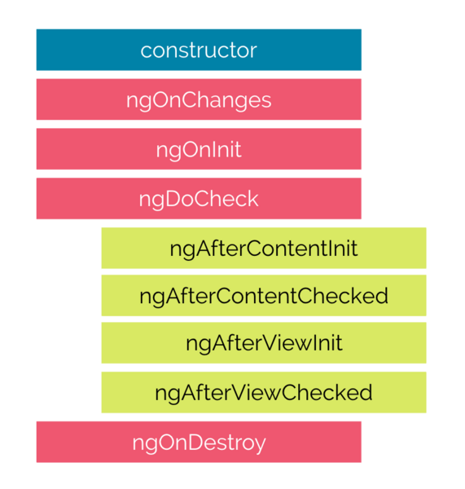
Component
A component in Angular has a life-cycle, a number of different phases it goes through from birth to death.
add some specific methods to component class which get called during each of these life-cycle phases called hooks.

Slide 7
Component
.
Constructor:
This is invoked when Angular creates a component or directive by calling new on the class.
ngOnChanges
Invoked every time there is a change in one of the input properties of the component.
ngOnInit
Invoked when given component has been initialized. This hook is only called once after the first ngOnChanges
ngDoCheck
Invoked when the change detector of the given component is invoked. It allows us to implement our own change detection algorithm for the given component.

Slide 8
Component
.
Hooks for the Component Children
ngAfterContentInit
Invoked after Angular performs any content projection into the components view.
ngAfterContentChecked
Invoked each time the content of the given component has been checked by the change detection mechanism of Angular.
ngAfterViewInit
Invoked when the component’s view has been fully initialized.
ngAfterViewChecked
Invoked each time the view of the given component has been checked by the change detection mechanism of Angular.

Slide 9
Change Detection
- A View is a fundamental building block of the application UI.
It is the smallest grouping of Elements which are created and destroyed together.
Properties of elements in a View can change
Changing the structure of Elements can only be done by inserting, moving or removing nested Views via a ViewContainerRef.
Each view has a link to its child views through nodes property and hence can perform actions on child views. (Shadow DOM)

Slide 10
Change Detection
View state
Each view has a state .
Based on its value , Angular decides whether to run change detection for the view and all its children or skip it.
States:
1. FirstCheck
2. ChecksEnabled
3. Errored
4. Destroyed

Slide 11
Change Detection
- Change detection is skipped for the view and its child views if ChecksEnabled is false or view is in the Errored or Destroyed state.
By default, all views are initialized with ChecksEnabled unless ChangeDetectionStrategy.OnPush is used
ViewRef encapsulates underlying component view and has detectChanges method.
When an asynchronous event takes place, Angular triggers change detection on its top-most ViewRef, which after running change detection for itself runs change detection for its child views.

Slide 12
Change Detection
viewRef is injected into a component constructor using ChangeDetectorRef
export class AppComponent { constructor(cd: ChangeDetectorRef) { ... }
export declare abstract class ChangeDetectorRef { abstract checkNoChanges(): void; abstract detach(): void; abstract detectChanges(): void; abstract markForCheck(): void; abstract reattach(): void; }
export abstract class ViewRef extends ChangeDetectorRef { ... }

Slide 13
Change Detection
Change detection operations
The main logic responsible for running change detection for a view resides in checkAndUpdateView function. (Diffing and Reconcile)
This function is called recursively for each component starting from the host component.

Slide 14
Change Detection
Every component can get a hold of its associated view through ChangeDetectorRef token
class ChangeDetectorRef { markForCheck() : void detach() : void reattach() : void detectChanges() : void checkNoChanges() : void }

Slide 15
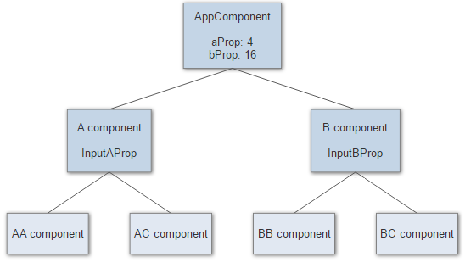
Change Detection - Example

Slide 16
Change Detection
@Component({ selector: 'a-comp', template: `<span>See if I change: {{changed}}</span>` }) export class AComponent { constructor(public cd: ChangeDetectorRef) { this.changed = 'false'; setTimeout(() => { this.cd.detach(); this.changed = 'true'; }, 2000); }
ngOnChanges(values) { this.cd.reattach(); setTimeout(() => { this.cd.detach(); }) }

Slide 17
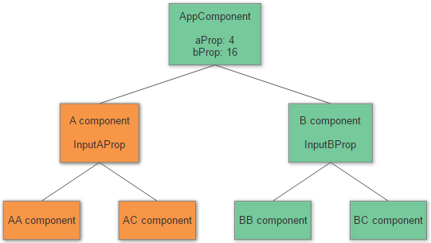
Change Detection - Example

Slide 18
Change Detection
export class AComponent { @Input() inputAProp; constructor(public cd: ChangeDetectorRef) { this.cd.detach(); } ngOnChanges(values) { this.cd.detectChanges(); }
DOM is updated when input property changes even though change detector reference remains detached.

Slide 19
Change Detection
When this function triggered for a particular view it does the following operations in the specified order:
sets ViewState.firstCheck to true if a view is checked for the first time and to false if it was already checked before
checks and updates input properties on a child component/directive instance
updates child view change detection state (part of change detection strategy implementation)
4.calls OnChanges lifecycle hook on a child component if bindings changed

Slide 20
Change Detection
5. calls OnInit and ngDoCheck on a child component
6. calls AfterContentInit and AfterContentChecked lifecycle hooks on child component instance
7. updates DOM interpolations for the current view if properties on current view component instance changed
8 . runs change detection for a child view
9. updates ViewChildren query list on the current view component instance
calls AfterViewInit and AfterViewChecked lifecycle hooks on child component instance

Slide 21
Oracle
Sql server
MongoDB
ORM
Hibernate
ADO.Net EF
Mongooose
(CRUD)
Spring REST
Web API
Express /Restify
B A L
(RESTful Services)
Get , Post , Put, Delete
D A L
Http
Enterprise App
Ajax (HttpModule)
AuthService
ProductService
Read, Save, Update, Remove
LoggerService
Model
ProductComponent
xyzComponent
Routing
Index.html
(SPA)
Guards

